Slide 1
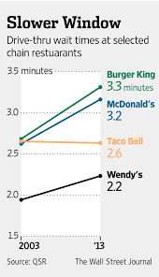
Fast food App by Victor Laureano Date: 01/20
Identify:
Fast food Customers are complaining about longer wait times and long lines.
The complexity of the menu is one of the main reasons for bigger times.
Countermeasures:
Countermeasure #1: Let customer decide menu items before arriving using a Web Application
Countermeasure #2: Have the menu item ready before customer arrival using a QR code generated from picking menu
Graph done by: The Wall Street Journal
Check:
Countermeasures should provide a 30% reduce in wait periods
Target:
1) Decrease customer wait time.
2) Help Customers in Menu picking
Act or Standarize:
Improve on the Application by fixing bugs and improving UX.
Future Improvements:
Downloadable App
Fast Food to Go
Branch and provide service for many Fast Foods
Analyze causes:
The complexity of the menu items is one of the main reasons for customers taking too long with their orders.
Confusion while asking for menu items, and waiting to be attended are the root causes

